Slide 1
SECTION 2
Chapter 6, 7, 8 and 9

Slide 2
Introduction
Yu (Zoey) Zhu
Email: yuzhu201@ucsc.edu
Sections: Friday, 5 - 6 PM
No Office Hour and Attend Lectures
Section Materials: https://github.com/YuZoeyZhu/STAT05-TANotes

Slide 3
Measurement Error
Chance Error
Bias / System Error
Outliers
CHAPTER 6

Slide 4
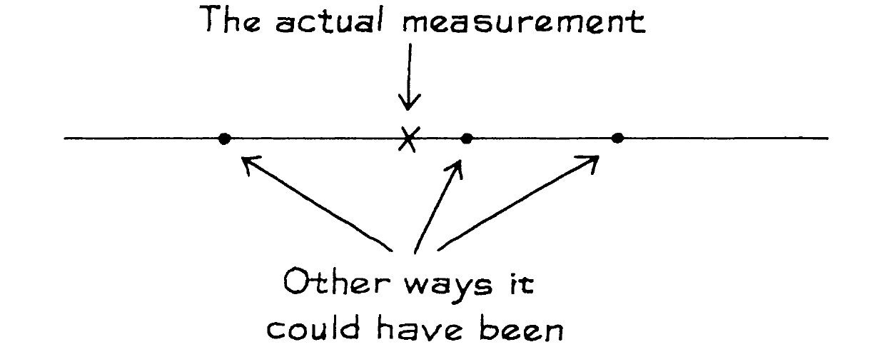
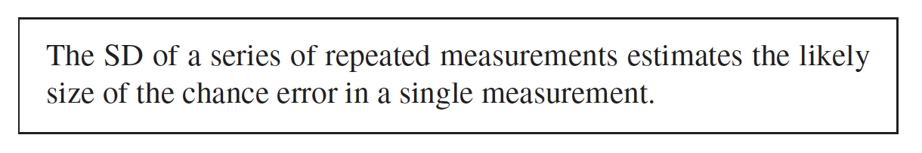
Chance Error
If the same thing is measured several times, the same result would be obtained each time. But in practice, there are differences because of chance error.
Chance error: error changes from measurement to measurement
Whenever a measurement is taken, and no matter how carefully it is made any measurement is subject to chance error.
individual measurement = exact value + chance error

Slide 5
Bias / System Error
Example: a butcher weighs a steak with his thumb on the scale
Bias affects all measurements the same way, pushing them in the same direction, either too high or too low.
Chance errors change from measurement to measurement, sometimes up and sometimes down.
So the modification of the previous equation:
individual measurement = exact value + bias + chance error

Slide 6
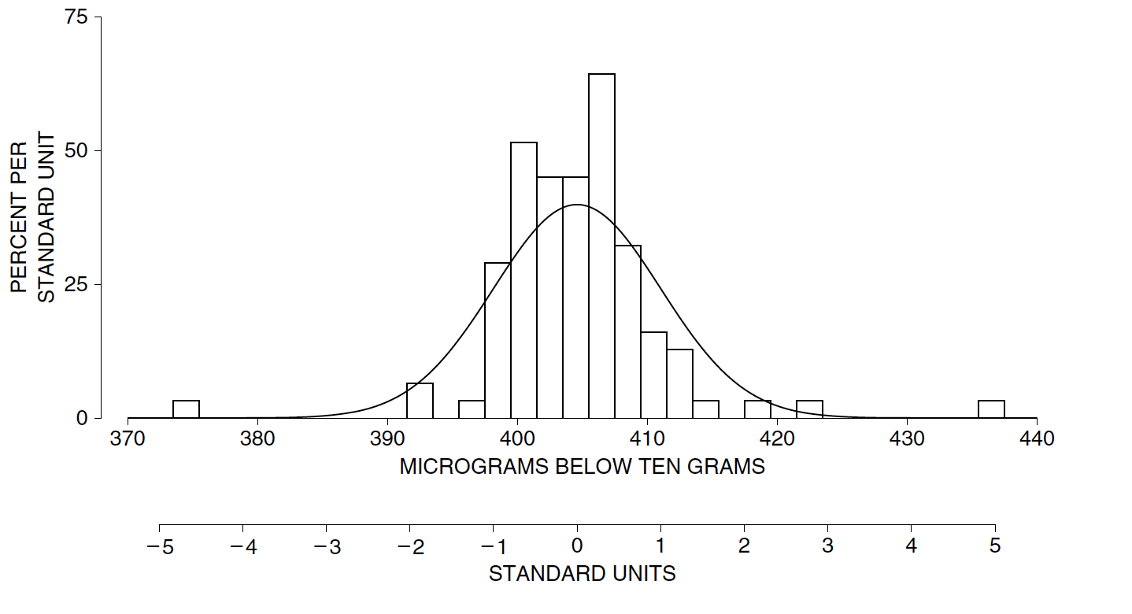
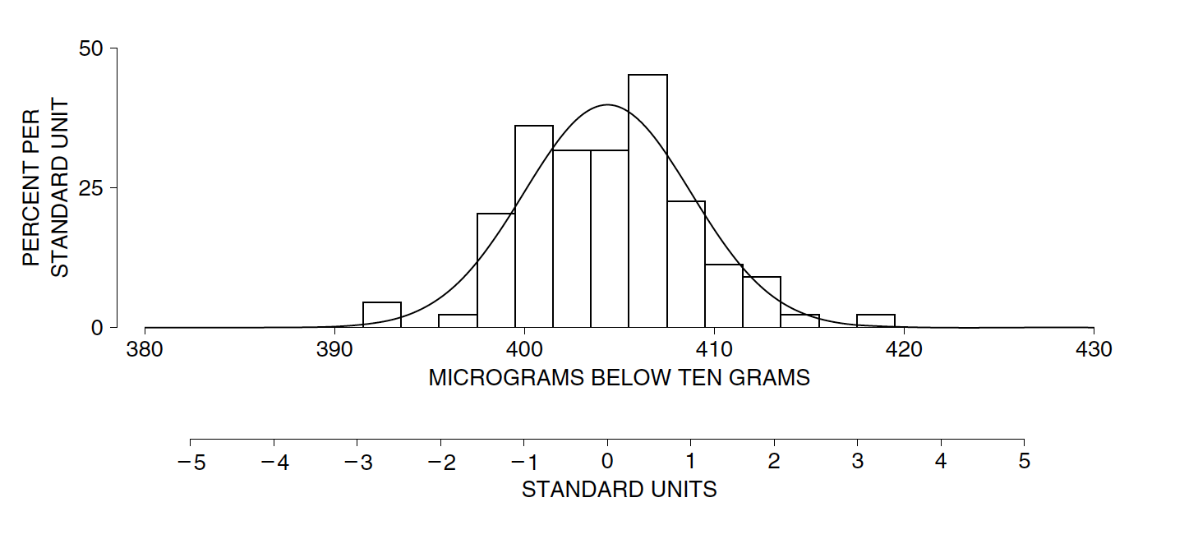
Outliers
Measurements which are far out of the range of the other measurement.
How far out does it have to be to be an outlier? A rule of thumb is 3 SD’s. But it still depends.
What can we do about outliers?
Ignore them
Drop those as bad data points and make the left data be closer to the normal curve
Analyze separately and report them as outliers

Slide 7
Plotting Points and Lines
Read and Plot Points
Slope and Intercept
Algebraic Equation for a Line
CHAPTER 7

Slide 8
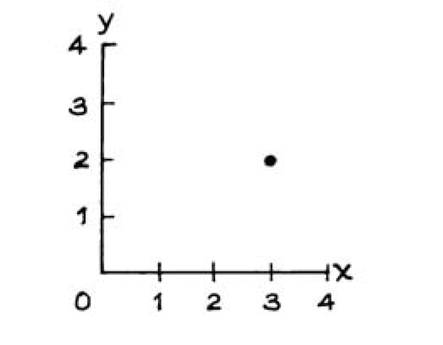
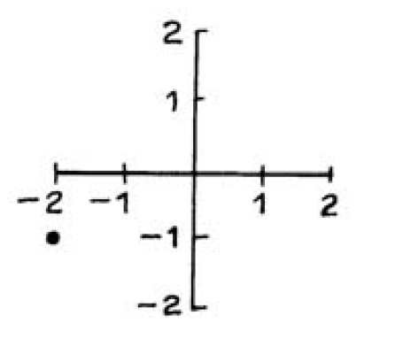
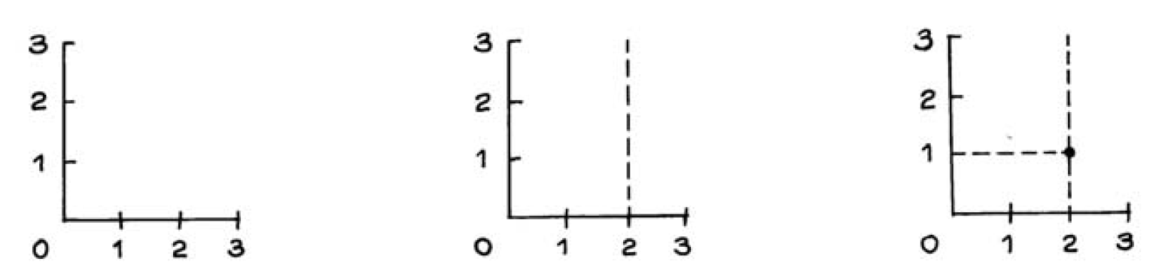
Read and Plot Points
Read points: in x- and y-coordinates, (x, y)
x = 3, y = 2, (3, 2)
x = -2, y = -1, (-2, -1)
Plot points: in x- and y-coordinates, for data point (x, y), locate x on the x-axis and y on the y-axis
(2, 1)

Slide 9
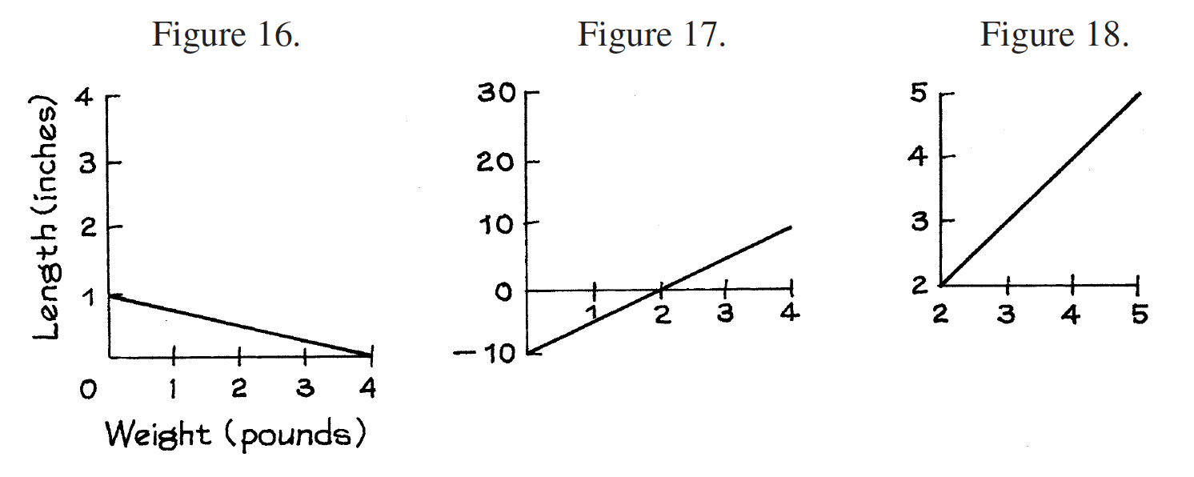
Slope and Intercept
Slope: the rate at which y increases with x, along the line. slope = rise/run
Intercept: the height when x = 0.
Slope Calculation Method:
Find two points in the line, A and B. Find the rise and run, then do the calculation
NOTE:
For some lines with same slopes, they are parellel with each other
With the positive slope, the line shows the increasing trend
With the negative slope, the line shows the decreasing trend
The larger the absolute value of slope, the steeper the line
Exercises:

Slide 10

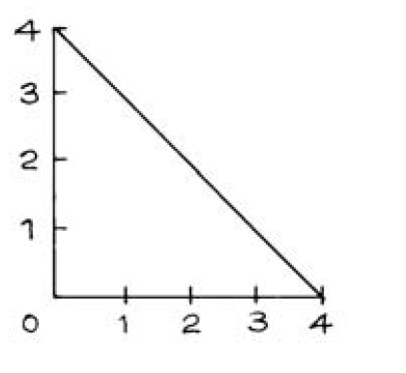
Algebraic Equation for a Line
Equation y = mx +b is a straight line, with slope m and intercept b. [Two points can define one line]
Type I. Given an equation, plot the line.
Type II. Given a line, find out the equation.
Type III. Given a line/equation, find out if some points are on this line.
Eg: Given a line y = x – 4, if (0.5, -5) is in this line
Type IV. Given three points, find out if they are on one line.

Slide 11
Correlation
Scatter Plot
Correlation Coefficient
SD Line
Correlation Coefficient Computation
CHAPTER 8 & 9

Slide 12
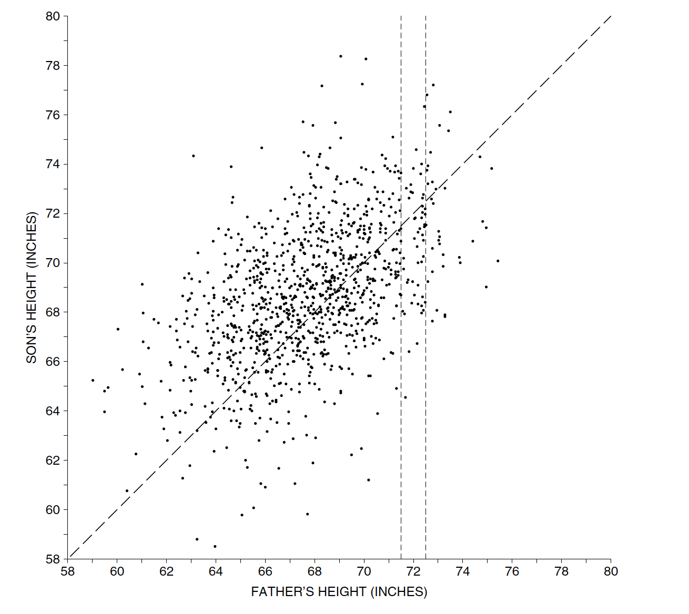
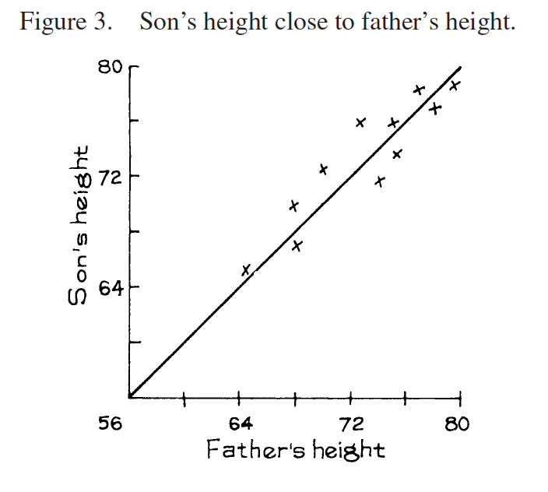
Scatter Plot
• A scatterplot or scatter diagram is a two-dimensional plot of data. The horizontal dimension is called x, and the vertical dimension is called y.
• Each point on a scatterplot or scatter diagram shows two values, an x value and a y value. Each point represents a single case. A single case could be a single person or object, but a single case could be a matched pair (e.g. father-son, twins, husband-wife)
• Scatter diagrams only show association, but association does not mean causation
A positive association
between the heights of fathers and sons
The swarm of points slopes upward to the right, the y-coordinates of the points tending to increase with their x-coordinates.

Slide 13
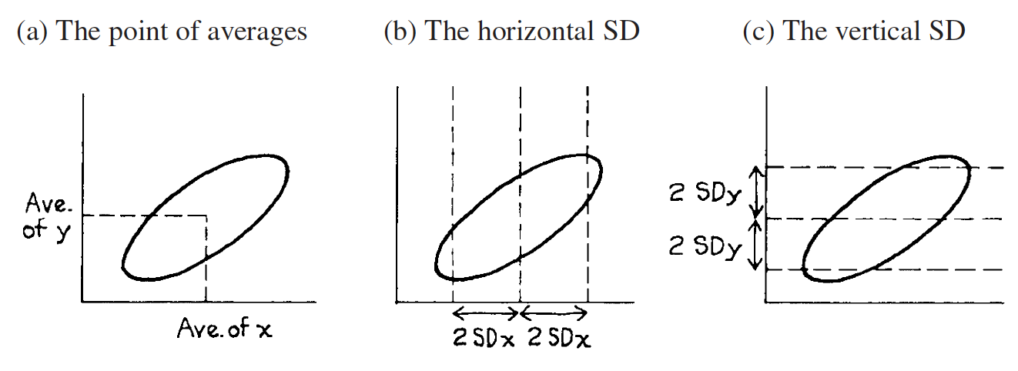
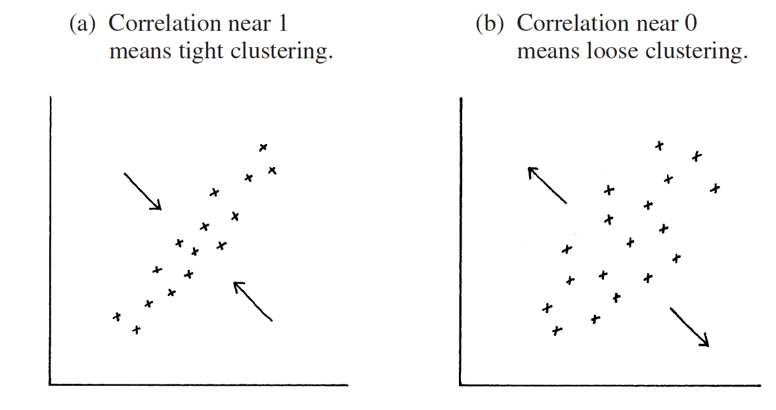
Correlation Coefficient
The Correlation Coefficient, denoted r, measures how close the data are to a straight line, or in other words, it measures the strength of association.
The relationship between two variables can be summarized by:
The average of the x-values, the SD of the x-values
The average of the y-values, the SD of the y-values
The correlation coefficient r

Slide 14
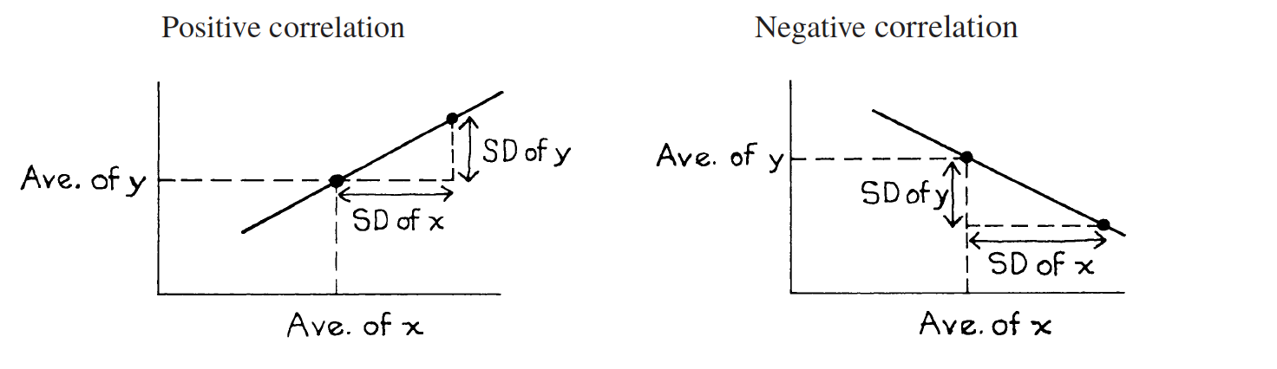
SD Line
The points in a scatter diagram generally seem to cluster around the SD line.
Goes through the point of averages
Goes through all the points which are an equal number of SDs away from the average, for both variables
Avg of y = Intercept + Slope $×$ Avg of x
Slope: (SD of y)/(SD of x)
Slope: -(SD of y)/(SD of x)

Slide 15
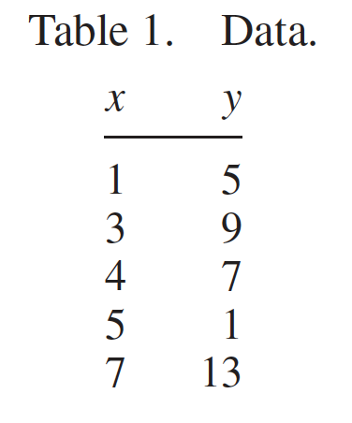
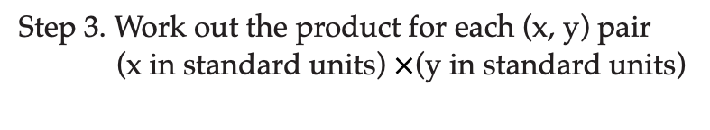
Correlation Coefficient Computation
Method I:
r = average of (x in standard units)$×$(y in standard units) where standard units = $\frac{ \text{value}\text{ – }\text{average}}{SD}$
Method II:
r = $\frac{cov(x, y)}{(SD of x)×(SD of y)}$ where cov(x, y) = average of products xy – (average of x) $×$ (average of y)
Method I:
Method II:
Step 1. Convert the x-values to standard units
Step 1. Calculate the average of products xy,
avg of x, avg of y
Step 2. Convert the y-values to standard units
Step 3. Work out the product for each (x, y) pair
(x in standard units) $×$(y in standard units)
Step 2. Calculate covariance cov(x, y)
Step 3. Calculate SD of x, SD of y
Step 4. Take the average of the products
Step 4. Divide covariance by the product of
SD of x and SD of y
Mean_x = 4, Mean_y = ; SD_x = 2, SD_y = 4

Slide 16
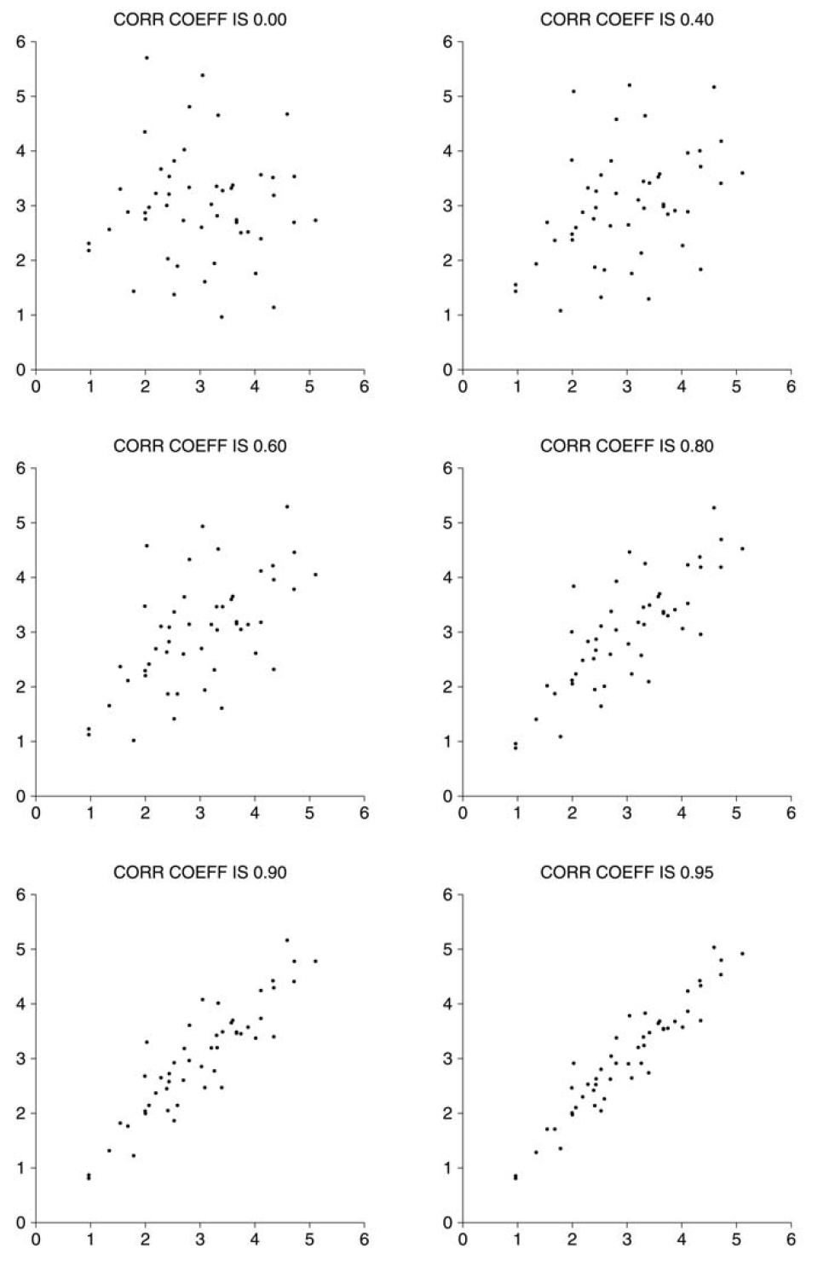
• -1 <= r <= 1
• The correlation r measures how close the data are to a line
• If r is close to 1 or -1, the data are close to a line
• If r is close to 0, the data are not close to a line
• r does NOT tell what percentage of the data fall on the line
• r = 0.80 does not indicate twice as much linearity as r = 0.40
• The correlation between x and y is the same as the correlation between y and x. r(x, y)=r(y, x)
• Invariant under addition: If some constant "a" is added to every one of the X or the Y values, the correlation is unchanged
• Invariant under multiplication: if all the x or the y values are multiplied by some positive constant "b", the correlation is unchanged. The correlation can change very dramatically if only ONE of the data points is changed

